Slide 1
Financial Statement Analysis
Learning Objectives
1
Apply horizontal and vertical analysis to financial statements.
2
Analyze a company’s performance using ratio analysis.
3
Apply the concept of sustainable income.

Slide 2
LEARNING
OBJECTIVE
Apply horizontal and vertical analysis to financial statements.
1
Analyzing financial statements involves:
Characteristics
Comparison
Bases
Tools of
Analysis
Liquidity
Profitability
Solvency
Intracompany
Industry averages
Intercompany
Horizontal
Vertical
Ratio
LO 1

Slide 3
Horizontal Analysis
Horizontal analysis, also called trend analysis, is a technique for evaluating a series of financial statement data over a period of time.
Purpose is to determine the increase or decrease.
Commonly applied to the
balance sheet,
income statement, and
statement of retained earnings.
LO 1

Slide 4
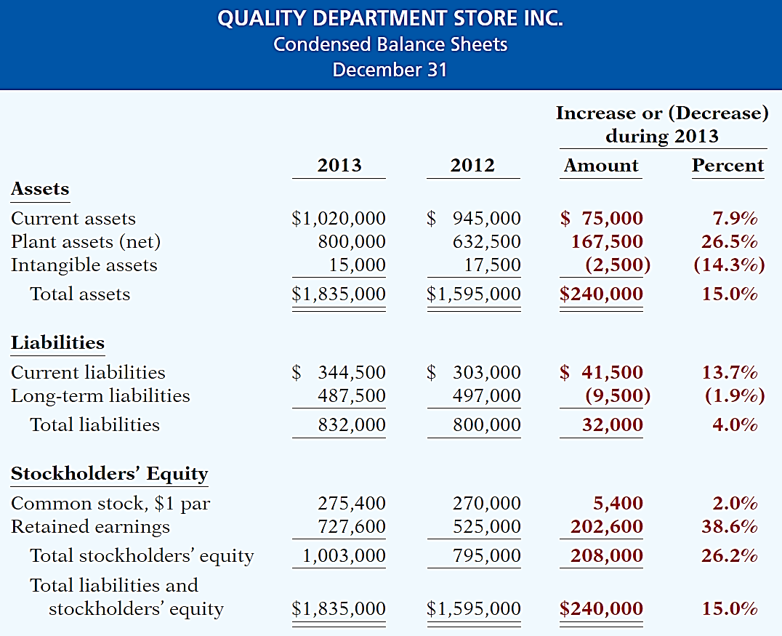
Horizontal Analysis
Illustration 18-5
Horizontal analysis of
balance sheets
Changes suggest that the company expanded its asset base during 2013 and financed this expansion primarily by retaining income rather than assuming additional long-term debt.
LO 1

Slide 5
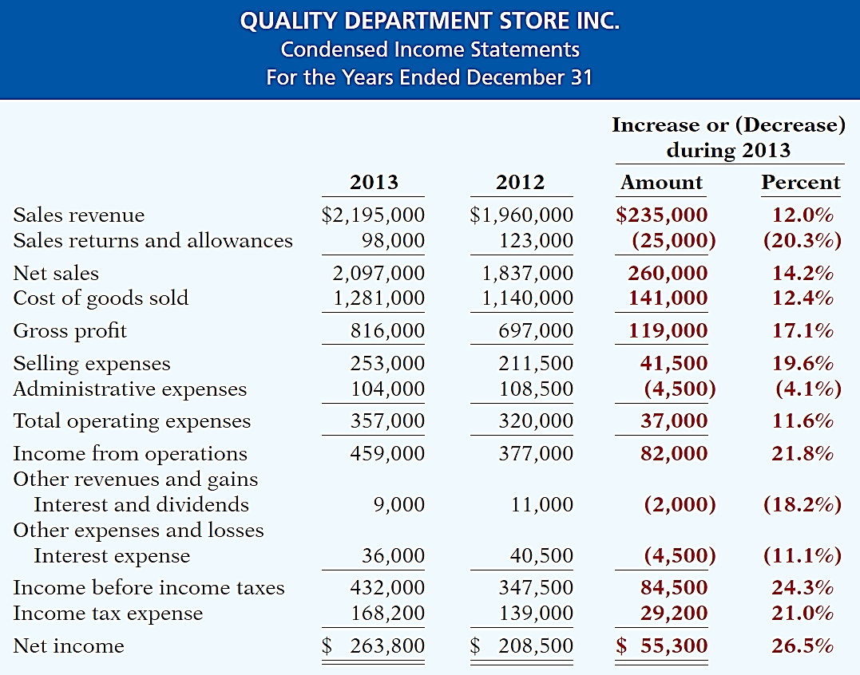
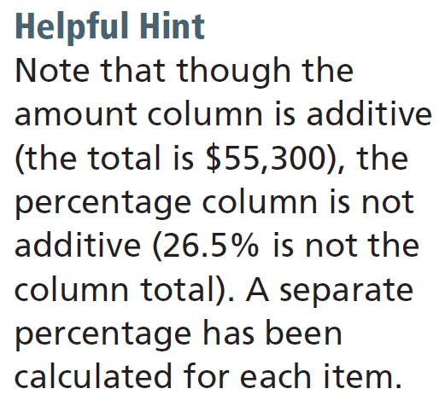
Horizontal Analysis
Illustration 18-6
Horizontal analysis of
Income statements
Overall, gross profit and net income were up substantially. Gross profit increased
17.1%, and net income, 26.5%. Quality’s profit trend appears favorable.
LO 1

Slide 6
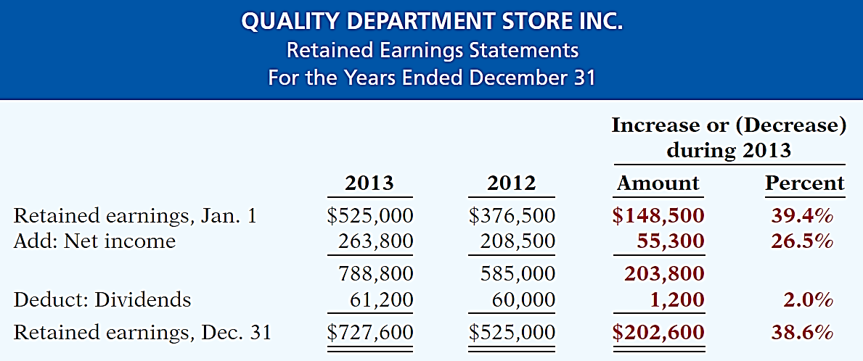
Horizontal Analysis
Illustration 18-7
Horizontal analysis of
retained earnings statements
The ending retained earnings increased 38.6%. As indicated earlier, the company retained a significant portion of net income to finance additional plant facilities.
LO 1

Slide 7
Vertical Analysis
Vertical analysis, also called common-size analysis, is a technique that expresses each financial statement item as a percent of a base amount.
On an income statement, we might say that selling expenses are 16% of net sales.
Vertical analysis is commonly applied to the
balance sheet and
income statement.
LO 1

Slide 8
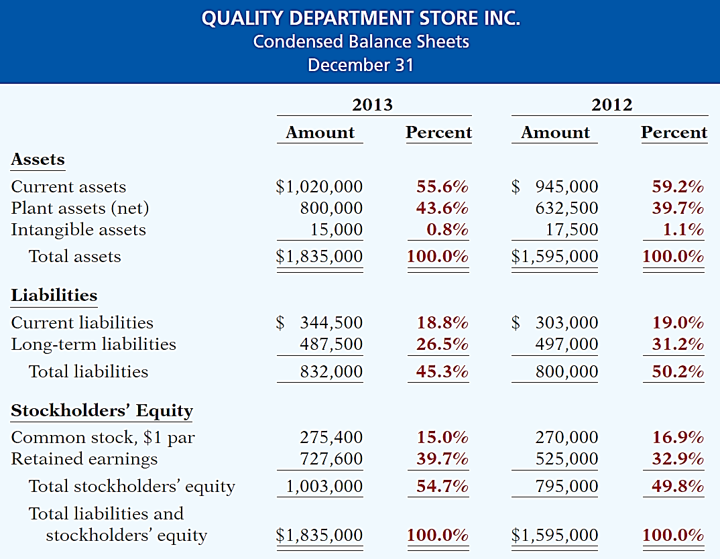
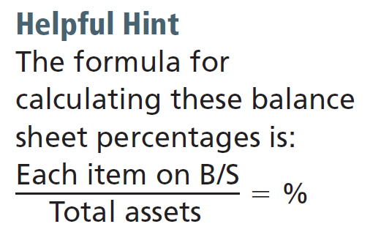
Vertical Analysis
Illustration 18-8
Vertical analysis of
balance sheets
Quality is choosing to finance its growth through retention of earnings rather than through issuing additional debt.
LO 1

Slide 9
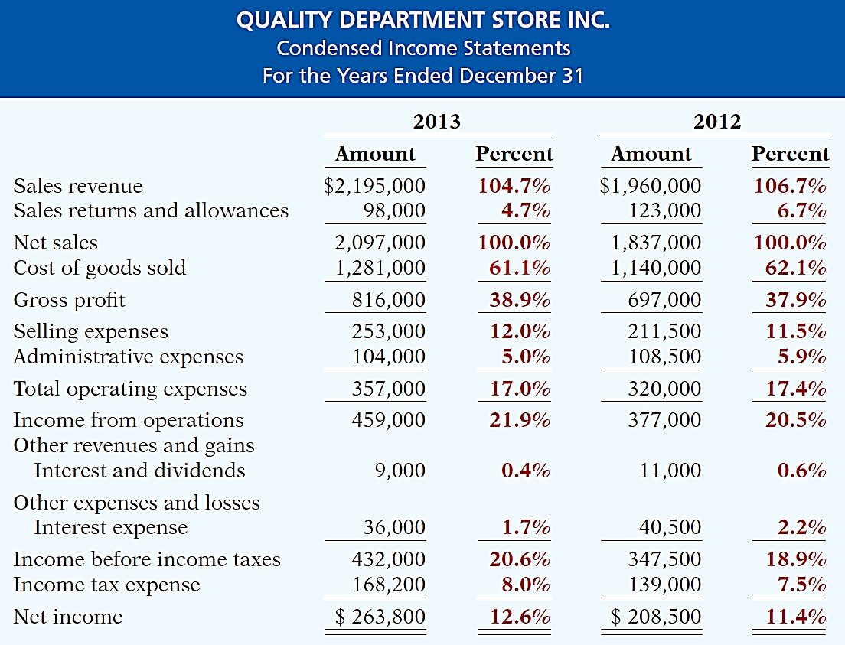
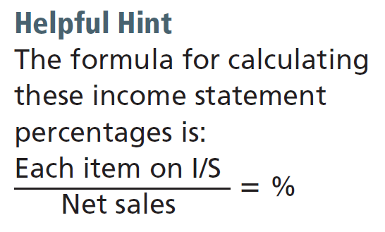
Vertical Analysis
Illustration 18-9
Vertical analysis of
Income statements
Quality appears
to be a profitable enterprise that is becoming even more successful.
LO 1

Slide 10
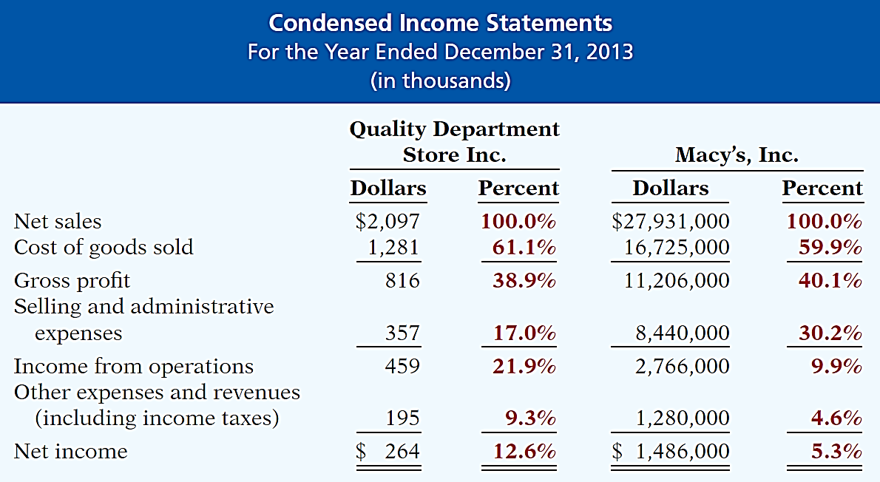
Vertical Analysis
Enables a comparison of companies of different sizes.
Illustration 18-10
Intercompany income statement comparison
LO 1

Slide 11
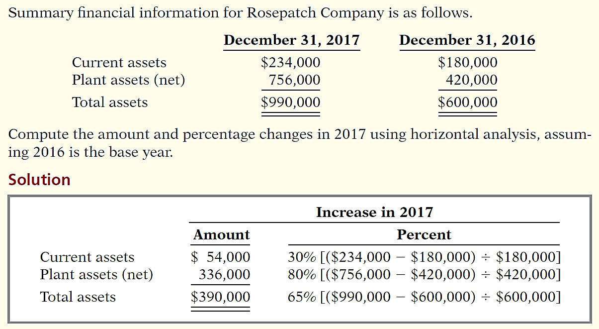
DO IT!
1
Horizontal Analysis
LO 1

Slide 12
LEARNING
OBJECTIVE
Analyze a company’s performance using ratio analysis.
2
Ratio analysis expresses the relationship among selected items of financial statement data.
Financial Ratio Classifications
Liquidity
Profitability
Solvency
Measures short-term ability of the company to pay its maturing obligations and to meet unexpected needs for cash.
Measures the income or operating success of a company for a given period of time.
Measures the ability of the company to survive over a long period of time.
LO 2

Slide 13
Ratio Analysis
A single ratio by itself is not very meaningful.
The discussion of ratios include the following types of comparisons.
Intracompany comparisons for two years for Quality Department Store.
Industry average comparisons based on median ratios for department stores.
Intercompany comparisons based on Macy’s, Inc. as Quality Department Store’s principal competitor.
LO 2

Slide 14
Ratio Analysis
Liquidity Ratios
Measure the short-term ability of the company to pay its maturing obligations and to meet unexpected needs for cash.
Short-term creditors such as bankers and suppliers are particularly interested in assessing liquidity.
Ratios include the current ratio, the acid-test ratio, accounts receivable turnover, and inventory turnover.
LO 2

Slide 15
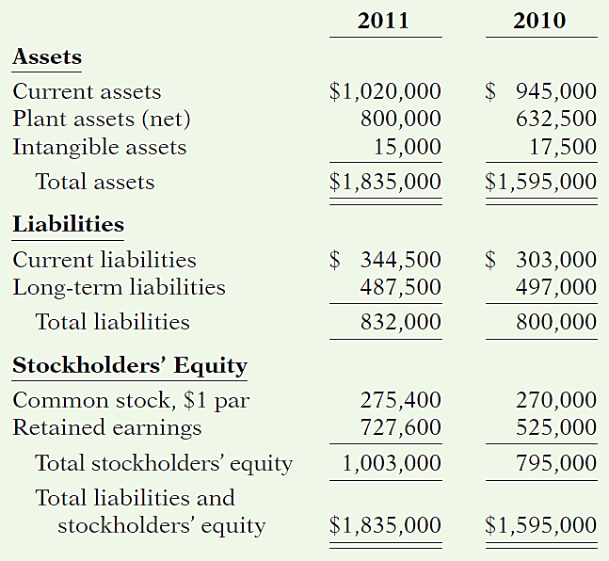
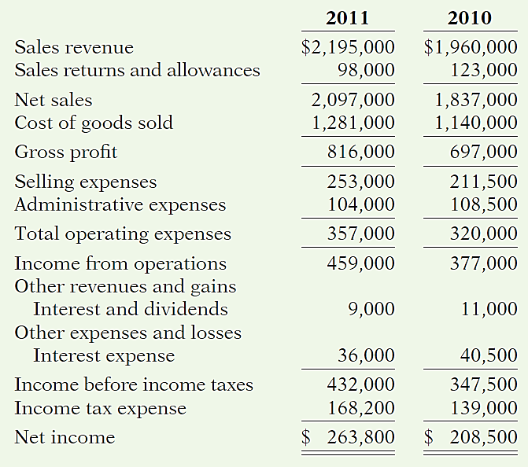

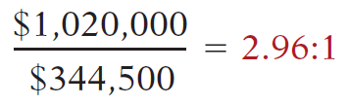
QUALITY DEPARTMENT STORE INC.
Balance Sheet (partial)
QUALITY DEPARTMENT STORE INC.
Condensed Income Statements
For the Years Ended December 31
2013
2012
2013
2012
Illustration 18-12
LO 2

Slide 16
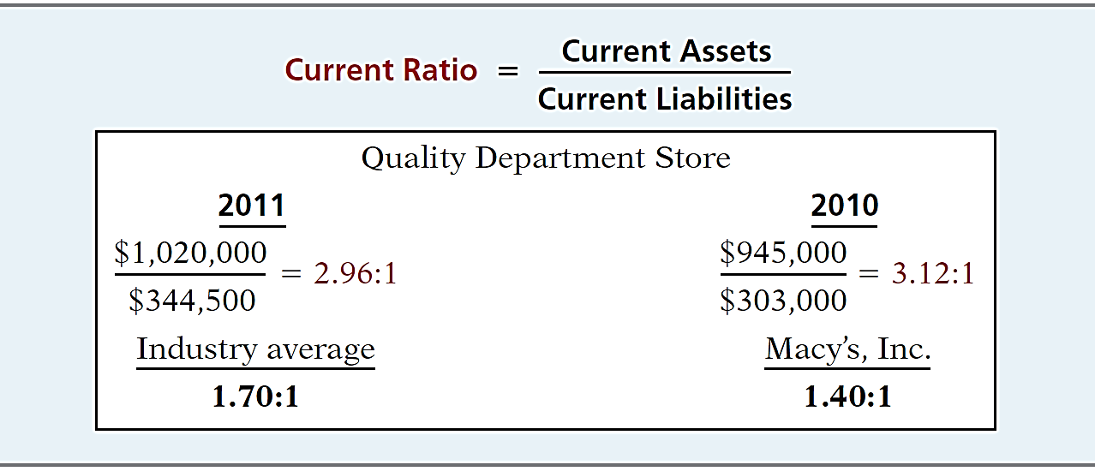
Liquidity Ratios
Ratio Analysis
1. CURRENT RATIO
Illustration 18-12
2013
2012
1.52:1
Ratio of 2.96:1 means that for every dollar of current liabilities, Quality has $2.96 of current assets.
LO 2

Slide 17
Investor Insight
How to Manage the Current Ratio
The apparent simplicity of the current ratio can have real-world limitations because adding equal amounts to both the numerator and the denominator causes the ratio to decrease.
Assume, for example, that a company has $2,000,000 of current assets and $1,000,000 of current liabilities. Thus, its current ratio is 2:1. If the company purchases $1,000,000 of inventory on account, it will have $3,000,000 of current assets and $2,000,000 of current liabilities. Its current ratio therefore decreases to 1.5:1. If, instead, the company pays off $500,000 of its current liabilities, it will have $1,500,000 of current assets and $500,000 of current liabilities. Its current ratio then increases to 3:1. Thus, any trend analysis should be done with care because the ratio is susceptible to quick changes and is easily influenced by management.
LO 2

Slide 18
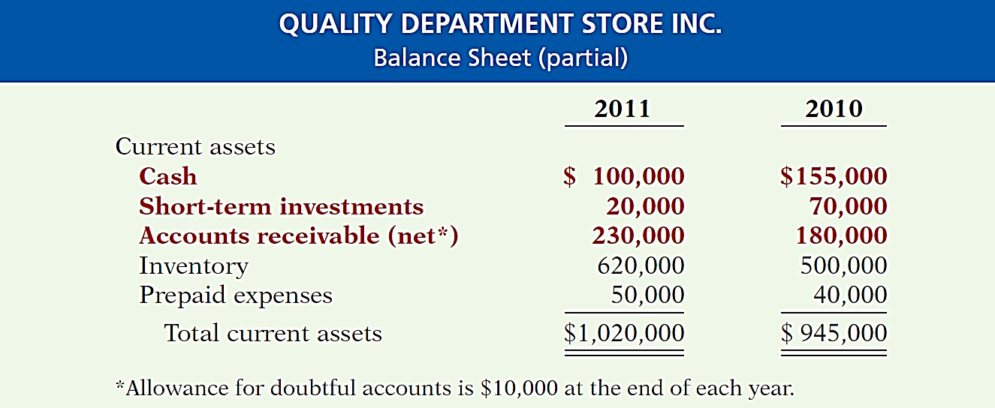
Liquidity Ratios
Ratio Analysis
2. ACID-TEST RATIO
Illustration 18-13
2013
2012
LO 2

Slide 19
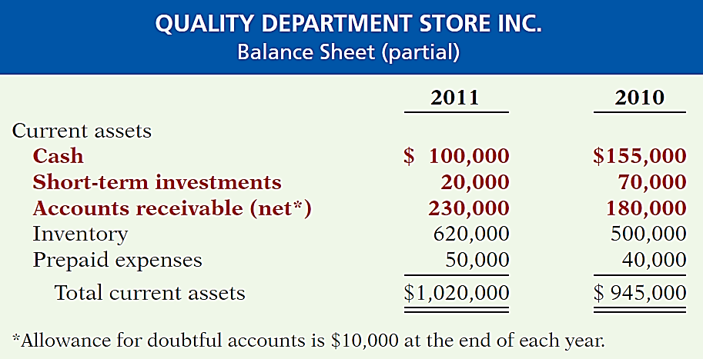
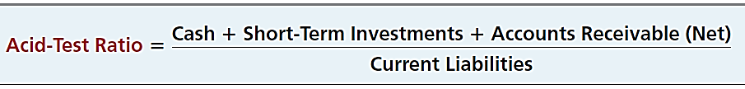
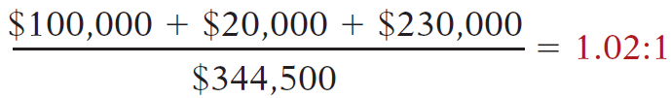
QUALITY DEPARTMENT STORE INC.
Balance Sheet (partial)
QUALITY DEPARTMENT STORE INC.
Balance Sheet (partial)
2013
2012
2013
2012
Illustration 18-12
LO 2

Slide 20
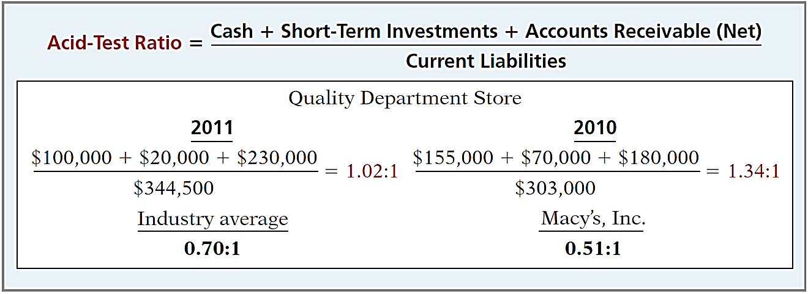
Liquidity Ratios
Ratio Analysis
2. ACID-TEST RATIO
Illustration 18-14
2013
2012
0.47:1
Acid-test ratio measures immediate liquidity.
LO 2

Slide 21
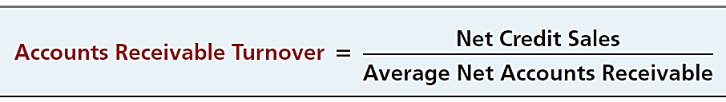
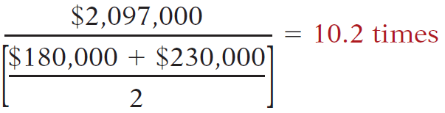
QUALITY DEPARTMENT STORE INC.
Balance Sheet (partial)
QUALITY DEPARTMENT STORE INC.
Condensed Income Statements
For the Years Ended December 31
2013
2012
2013
2012
LO 2

Slide 22
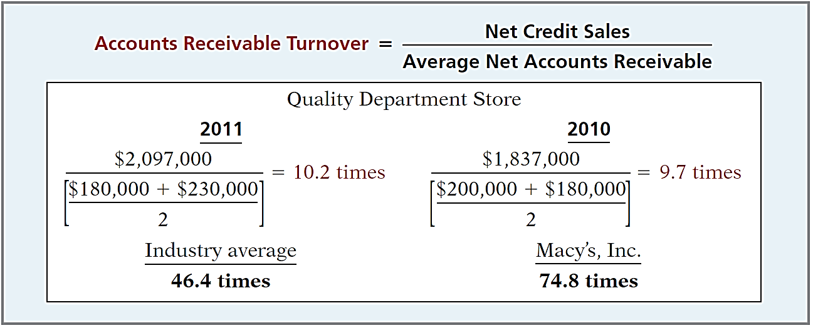
Liquidity Ratios
Ratio Analysis
3. ACCOUNTS RECEIVABLE TURNOVER
Illustration 18-15
2013
2012
69.1 times
Measures the number of times, on average, the company collects receivables during the period.
LO 2

Slide 23
Liquidity Ratios
Ratio Analysis
3. ACCOUNTS RECEIVABLE TURNOVER
$2,097,000
= 10.2 times
($180,000 + $230,000) / 2
A variant of the accounts receivable turnover ratio is to convert it to an average collection period in terms of days.
365 days / 10.2 times = every 35.78 days
Accounts receivable are collected on average every 36 days.
LO 2

Slide 24

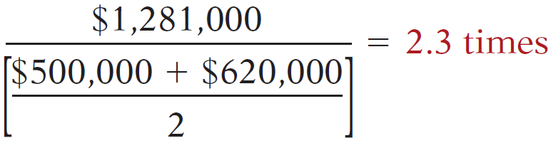
QUALITY DEPARTMENT STORE INC.
Balance Sheet (partial)
QUALITY DEPARTMENT STORE INC.
Condensed Income Statements
For the Years Ended December 31
2013
2012
2013
2012
Illustration 18-12
LO 2

Slide 25
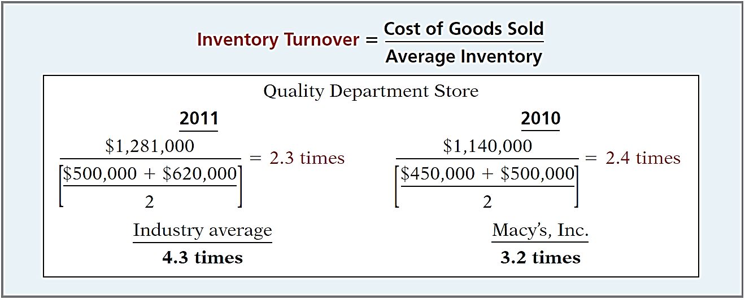
Liquidity Ratios
Ratio Analysis
4. INVENTORY TURNOVER
Illustration 18-16
2013
2012
3.1 times
Measures the number of times, on average, the inventory is sold during the period.
LO 2

Slide 26
Liquidity Ratios
Ratio Analysis
4. INVENTORY TURNOVER
$1,281,000
= 2.3 times
($500,000 + $620,000) / 2
A variant of inventory turnover is the days in inventory.
365 days / 2.3 times = every 159 days
Inventory turnover ratios vary considerably among industries.
LO 2

Slide 27
Ratio Analysis
Profitability Ratios
Measure the income or operating success of a company for a given period of time.
Income affects the company’s ability to obtain debt and equity financing, their liquidity position, and their ability to grow.
Ratios include the profit margin, asset turnover, return on assets, return on common stockholders’ equity, earnings per share, price-earnings ratio, and payout ratio.
LO 2

Slide 28
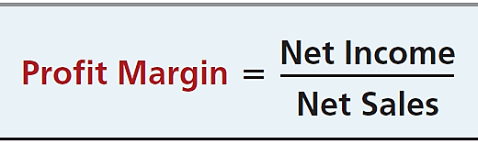
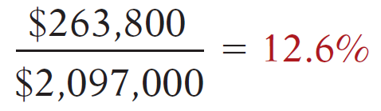
QUALITY DEPARTMENT STORE INC.
Condensed Balance Sheets
QUALITY DEPARTMENT STORE INC.
Condensed Income Statements
For the Years Ended December 31
2013
2012
2013
2012
LO 2

Slide 29
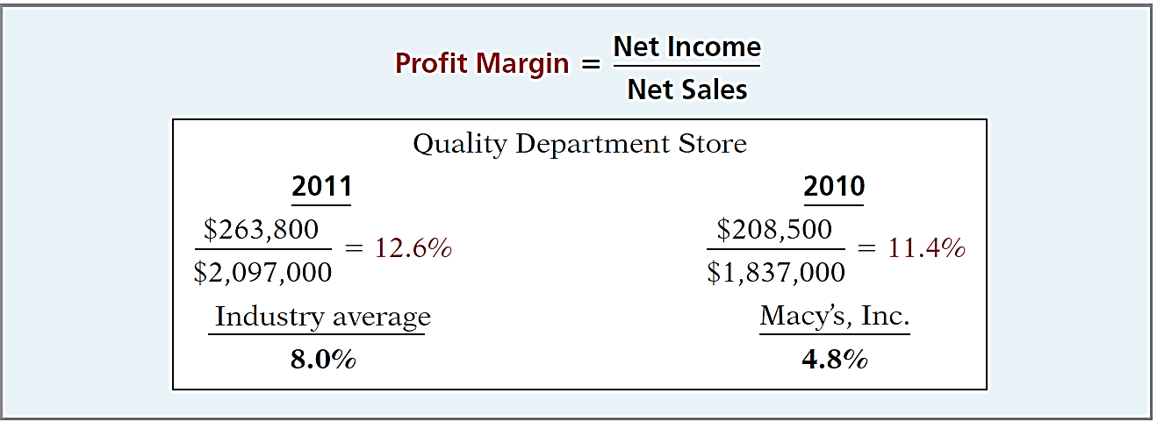
Profitability Ratios
Ratio Analysis
5. PROFIT MARGIN
Illustration 18-17
2013
2012
5.3%
Measures the percentage of each dollar of sales that results in net income.
LO 2

Slide 30

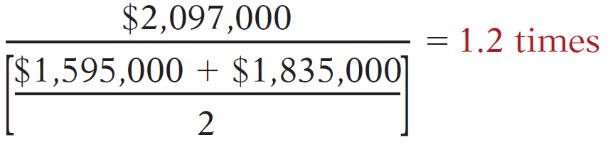
QUALITY DEPARTMENT STORE INC.
Condensed Balance Sheets
QUALITY DEPARTMENT STORE INC.
Condensed Income Statements
For the Years Ended December 31
2013
2012
2013
2012
Illustration 18-12
LO 2

Slide 31
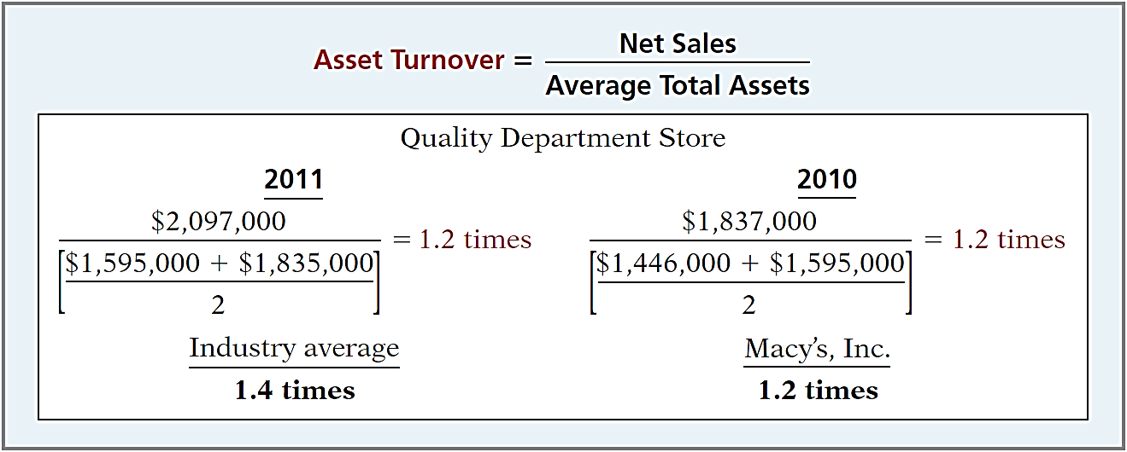
Profitability Ratios
Ratio Analysis
6. ASSET TURNOVER
Illustration 18-18
2013
2012
1.3 times
Measures how efficiently a company uses its assets to generate sales.
LO 2

Slide 32
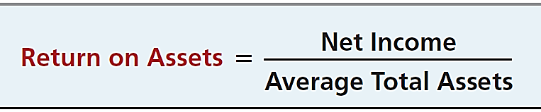
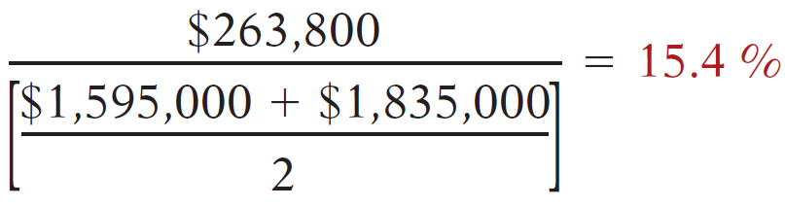
QUALITY DEPARTMENT STORE INC.
Condensed Balance Sheets
QUALITY DEPARTMENT STORE INC.
Condensed Income Statements
For the Years Ended December 31
2013
2012
2013
2012
Illustration 18-12
LO 2

Slide 33
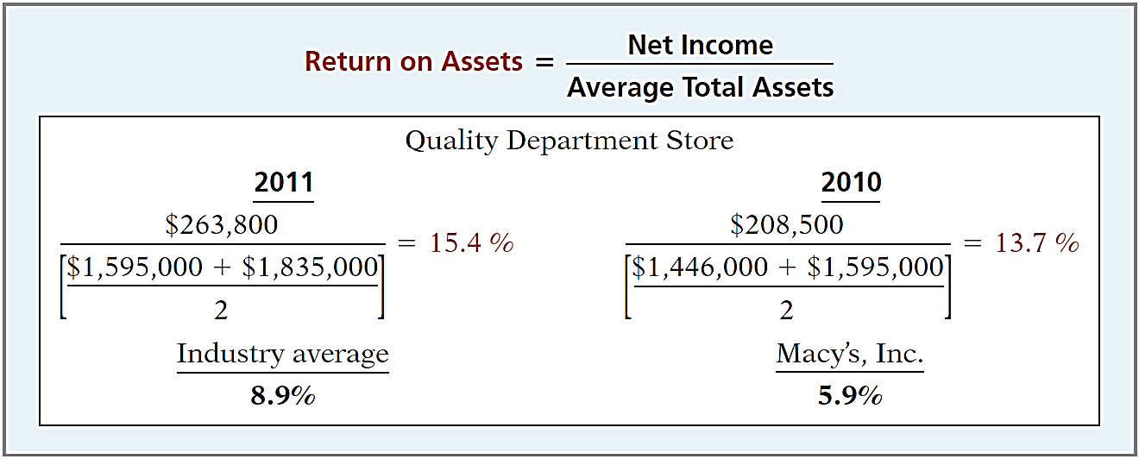
Profitability Ratios
Ratio Analysis
7. RETURN ON ASSETS
Illustration 18-19
2013
2012
7.0%
An overall measure of profitability.
LO 2

Slide 34
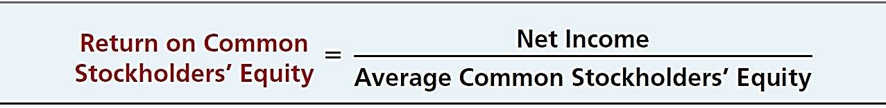
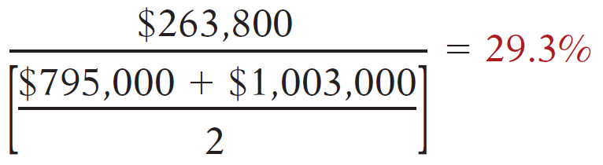
QUALITY DEPARTMENT STORE INC.
Condensed Balance Sheets
QUALITY DEPARTMENT STORE INC.
Condensed Income Statements
For the Years Ended December 31
2013
2012
2013
2012
Illustration 18-12
LO 2

Slide 35
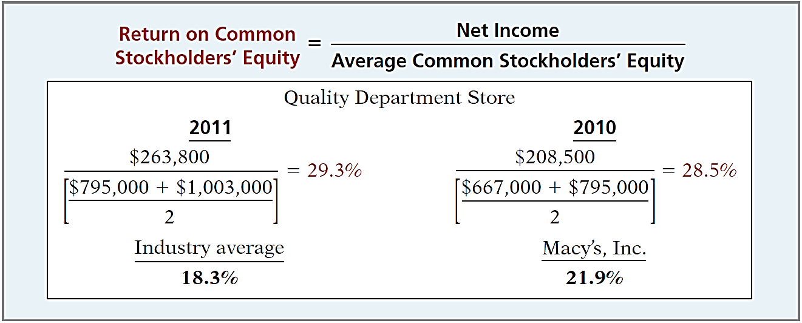
Profitability Ratios
Ratio Analysis
8. RETURN ON COMMON STOCKHOLDERS’ EQUITY
Illustration 18-20
2013
2012
24.2%
Shows how many dollars of net income the company earned for each dollar invested by the owners.
LO 2

Slide 36
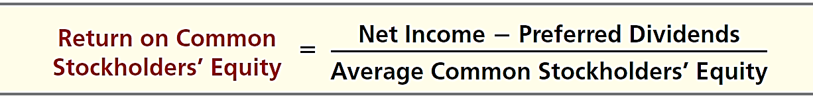
Profitability Ratios
Ratio Analysis
8. RETURN ON COMMON STOCKHOLDERS’ EQUITY
With Preferred Stock
Deduct preferred dividend requirements from net income.
Illustration 18-21
Return on common stockholders’
equity with preferred stock
LO 2

Slide 37
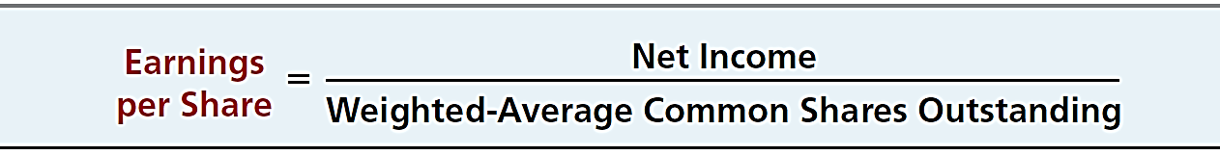
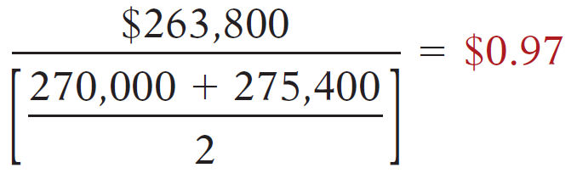
QUALITY DEPARTMENT STORE INC.
Condensed Balance Sheets
QUALITY DEPARTMENT STORE INC.
Condensed Income Statements
For the Years Ended December 31
2013
2012
2013
2012
Illustration 18-12
LO 2

Slide 38
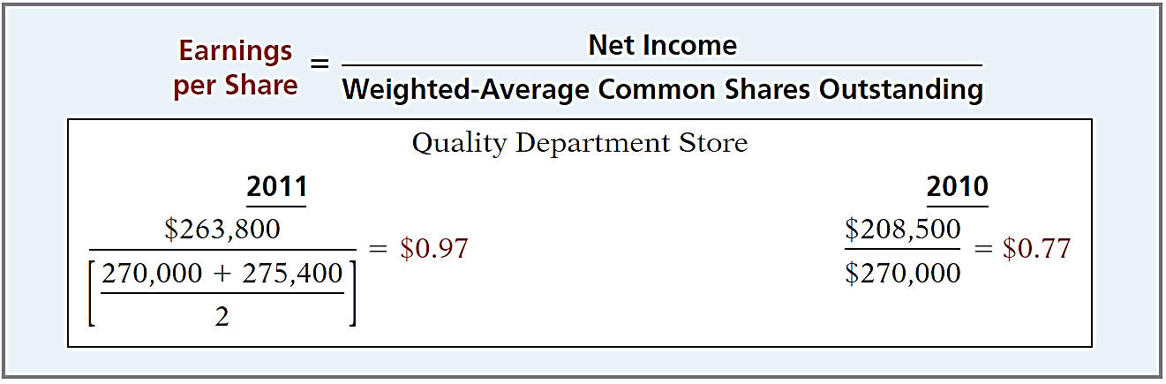
Profitability Ratios
Ratio Analysis
9. EARNINGS PER SHARE (EPS)
Illustration 18-22
2013
2012
A measure of the net income earned on each share of common stock.
LO 2

Slide 39
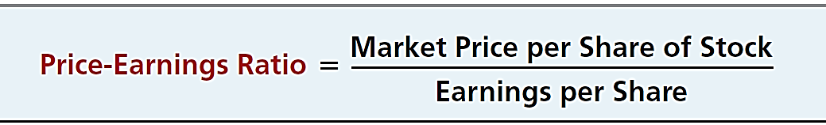
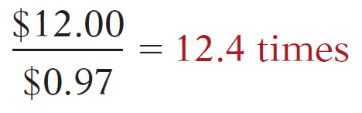
QUALITY DEPARTMENT STORE INC.
Condensed Balance Sheets
QUALITY DEPARTMENT STORE INC.
Condensed Income Statements
For the Years Ended December 31
2013
2012
2013
2012
Illustration 18-12
LO 2

Slide 40
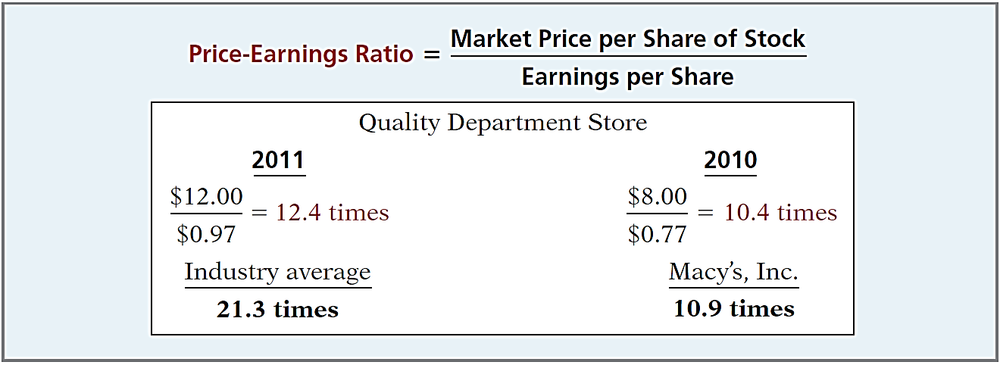
Profitability Ratios
Ratio Analysis
10. PRICE-EARNINGS RATIO
Illustration 18-23
2013
2012
13.5 times
Reflects investors’ assessments of a company’s future earnings.
LO 2

Slide 41
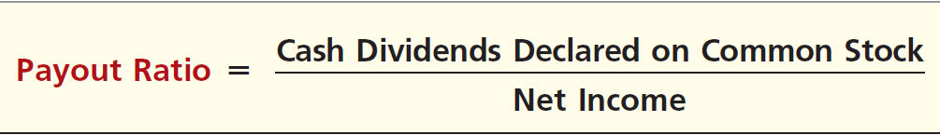
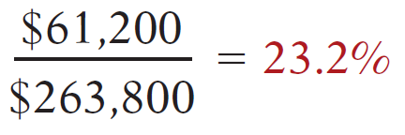
QUALITY DEPARTMENT STORE INC.
Condensed Balance Sheets
QUALITY DEPARTMENT STORE INC.
Condensed Income Statements
For the Years Ended December 31
2013
2012
2013
2012
Illustration 18-12
LO 2

Slide 42
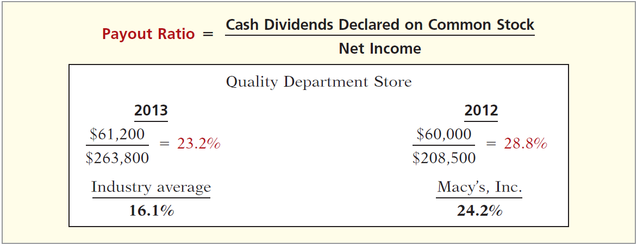
Profitability Ratios
Ratio Analysis
11. PAYOUT RATIO
Illustration 18-24
2013
2012
24.2%
Measures the percentage of earnings distributed in the form of cash dividends.
LO 2

Slide 43
Ratio Analysis
Solvency Ratios
Solvency ratios measure the ability of a company to survive over a long period of time.
Debt to Assets and
Times Interest Earned
are two ratios that provide information about debt-paying ability.
LO 2

Slide 44
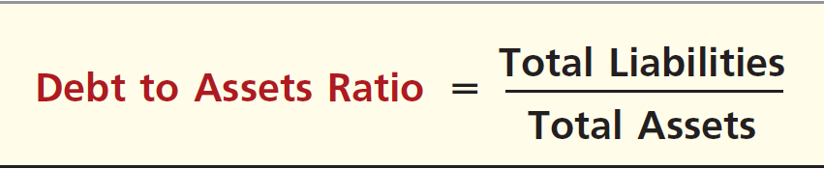
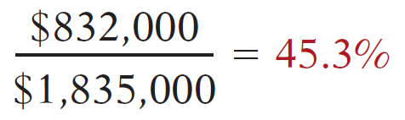
QUALITY DEPARTMENT STORE INC.
Condensed Balance Sheets
QUALITY DEPARTMENT STORE INC.
Condensed Income Statements
For the Years Ended December 31
2013
2012
2013
2012
Illustration 18-12
LO 2

Slide 45
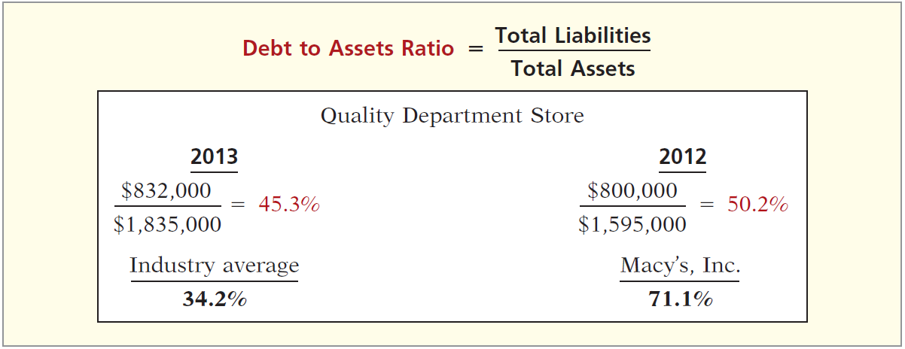
Solvency Ratios
Ratio Analysis
12. DEBT TO TOTAL ASSETS RATIO
Illustration 18-25
2013
2012
71.1%
Measures the percentage of the total assets that creditors provide.
LO 2

Slide 46
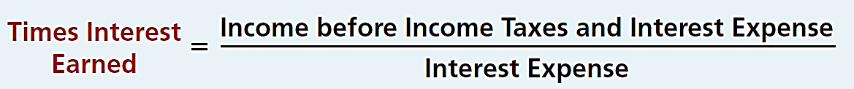

QUALITY DEPARTMENT STORE INC.
Condensed Balance Sheets
QUALITY DEPARTMENT STORE INC.
Condensed Income Statements
For the Years Ended December 31
2013
2012
2013
2012
Illustration 18-12
LO 2

Slide 47
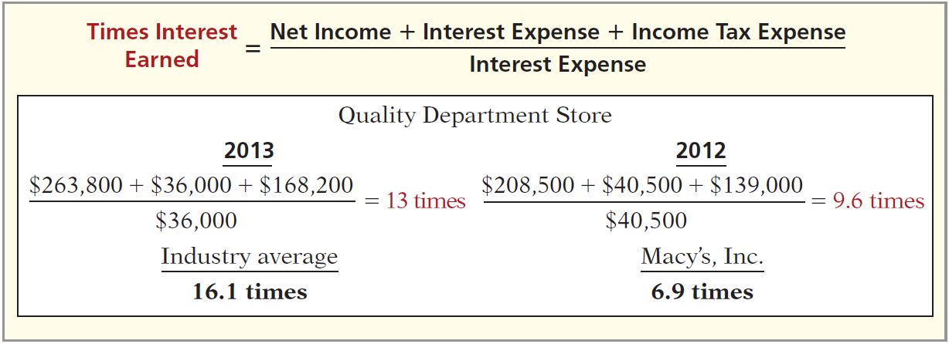

Solvency Ratios
Ratio Analysis
13. TIMES INTEREST EARNED
Illustration 18-26
Provides an indication of the company’s ability to meet interest payments as they come due.
LO 2

Slide 48

Ratio Analysis
Summary of Ratios
Illustration 18-27
LO 2

Slide 49


Summary of Ratios
Illustration 18-27
LO 2

Slide 50
LEARNING
OBJECTIVE
Apply the concept of sustainable income.
3
Sustainable income is the most likely level of income to be obtained by a company in the future. It differs from actual net income by the amount of unusual revenues, expenses, gains, and losses included in the current year’s income.
Information on unusual items such as gains or losses on discontinued items and components of other comprehensive income are disclosed.
These unusual items are reported net of income taxes.
LO 3

Slide 51
Discontinued Operations
Disposal of a significant component of a business.
Report the income (loss) from discontinued operations in two parts:
income (loss) from operations (net of tax) and
gain (loss) on disposal (net of tax).
LO 3

Slide 52
Discontinued Operations
Illustration: During 2017 AE Inc. has income before income taxes of $79,000,000. During 2017, AE Inc. discontinued and sold its unprofitable chemical division. The loss in 2017 from chemical operations (net of $135,000 taxes) was $315,000. The loss on disposal of the chemical division (net of $81,000 taxes) was $189,000. Assuming a 30% tax rate on income. Show how this discontinued operation would be presented on the income statement.
LO 3

Slide 53
Discontinued Operations
Discontinued Operations are reported after “Income from continuing operations.”
Previously labeled as “Net Income”.
Moved to
LO 3

Slide 54
Other Comprehensive Income
All changes in stockholders’ equity except those resulting from investments by stockholders and distributions to stockholders.
Reported in
Stockholders’ Equity
Unrealized gains and losses on available-for-sale securities.
Plus other items
+
LO 3

Slide 55
Other Comprehensive Income
Illustration: During 2017 Stassi Company purchased IBM stock for $10,000 as an investment. At the end of 2017, Stassi was still holding the investment, but the stock’s market price was now $8,000. In this case, Stassi is required to reduce the recorded value of its IBM investment by $2,000. The $2,000 difference is an unrealized loss.
Should Stassi include this $2,000 unrealized loss in net income? It depends on whether Stassi classifies the IBM stock as a trading security or an available-for-sale security.
Trading securities: Unrealized gains and losses are reported in the “Other expenses and losses” section of the income statement.
Available-for-sale securities: Unrealized gains and losses are reported as a direct adjustment to stockholders’ equity.
LO 3

Slide 56

Other Comprehensive Income
Assume Stassi Company classifies their investment in IBM stock as available-for-sale.
Illustration 18-30
Lower portion of statement of
comprehensive income
LO 3

Slide 57

Other Comprehensive Income
Assume Stassi Corporation has common stock of $3,000,000, retained earnings of $1,500,000, and an unrealized loss on available-for-sale securities of $2,000. Illustration 18-31 shows the balance sheet presentation of the unrealized loss.
Illustration 18-31
Unrealized loss in stockholders’ equity section
LO 3

Slide 58

Illustration 18-32
Complete statement of
comprehensive income
LO 3

Slide 59
DO IT!
3
Unusual Items
In its proposed 2017 income statement, AIR Corporation reports income before income taxes $400,000, unrealized gain on available-for-sale securities $100,000, income taxes $120,000 (not including unusual items), loss from operation of discontinued flower division $50,000, and loss on disposal of discontinued flower division $90,000. The income tax rate is 30%.
Prepare a correct statement of comprehensive income, beginning with “Income before income taxes.”
LO 3

Slide 60


DO IT!
3
Unusual Items
LO 3

Slide 61

A Look at IFRS
LEARNING
OBJECTIVE
Compare financial statement analysis and income statement presentation under GAAP and IFRS.
4
Relevant Facts
The tools of financial statement analysis covered in this chapter are universal and therefore no significant differences exist in the analysis methods used.
The basic objectives of the income statement are the same under both GAAP and IFRS. A very important objective is to ensure that users of the income statement can evaluate the sustainable income of the company.
LO 4

Slide 62
A Look at IFRS
Relevant Facts
The basic accounting for discontinued operations is the same under IFRS and GAAP.
The accounting for changes in accounting principles and changes in accounting estimates are the same for both GAAP and IFRS.
Both GAAP and IFRS follow the same approach in reporting comprehensive income.
LO 4

Slide 63
A Look at IFRS
Looking to the Future
The FASB and the IASB are working on a project that would rework the structure of financial statements. Recently, the IASB decided to require a statement of comprehensive income, similar to what was required under GAAP.
LO 4

Slide 64
A Look at IFRS
IFRS Self-Test Questions
The basic tools of financial analysis are the same under both GAAP and IFRS except that:
horizontal analysis cannot be done because the format of the statements is sometimes different.
analysis is different because vertical analysis cannot be done under IFRS.
the current ratio cannot be computed because current liabilities are often reported before current assets in IFRS statements of position.
None of the above.
LO 4

Slide 65
A Look at IFRS
IFRS Self-Test Questions
Presentation of comprehensive income must be reported under IFRS in:
the statement of stockholders’ equity.
the income statement ending with net income.
the notes to the financial statements.
a statement of comprehensive income.
LO 4

Slide 66
A Look at IFRS
IFRS Self-Test Questions
In preparing its income statement for 2017, Parmalane assembles the following information.
Sales revenue $500,000
Cost of goods sold 300,000
Operating expenses 40,000
Loss on discontinued operations 20,000
Ignoring income taxes, what is Parmalane’s income from continuing operations for 2017 under IFRS?
(a) $260,000.
(b) $250,000.
(c) $240,000.
(d) $160,000.
LO 4

Slide 67
Copyright
“Copyright © 2015 John Wiley & Sons, Inc. All rights reserved. Reproduction or translation of this work beyond that permitted in Section 117 of the 1976 United States Copyright Act without the express written permission of the copyright owner is unlawful. Request for further information should be addressed to the Permissions Department, John Wiley & Sons, Inc. The purchaser may make back-up copies for his/her own use only and not for distribution or resale. The Publisher assumes no responsibility for errors, omissions, or damages, caused by the use of these programs or from the use of the information contained herein.”

